Slide 1

Chandigarh University
Department of Mathematics
B.Tech. CSE (Core/DS/IT/CC)
Semester-3
Subject Code:25MTT-202
Discrete Mathematics
Unit-3 (Chapter- 3.2.2)
Dr. SARTAJ
DISCOVER . LEARN . EMPOWER

Slide 2

CO mappings

Slide 3

CO-PO mappings
Note: Degree of relevance/correlation: 1-Low, 2-Medium, 3-High, Blank or ‘- ‘- Nil

Slide 4
Topics Covered
Hasse Diagrams
Conclusions
Video links
References

Slide 5
Hasse Diagrams
It is a useful tool, which completely describes the associated partial order. Therefore, it is also called an ordering diagram. It is very easy to convert a directed graph of a relation on a set A to an equivalent Hasse diagram. Therefore, while drawing a Hasse diagram, the following points must be remembered.
Vertices in the Hasse diagram are denoted by points rather than by circles.
Since a partial order is reflexive, each vertex of set A must be related to itself. So, the edges from a vertex to itself are deleted in the Hasse diagram.
ns

Slide 6
Hasse Diagrams
3. Since a partial order is transitive, hence whenever aRb and bRc, we have aRc. Eliminate all edges that are implied by the transitive property in the Hasse diagram, i.e., delete edge from a to c but retain the other two edges.
4. If a vertex ‘a’ is connected to vertex ‘b’ by an edge (i.e., aRb), then vertex ‘b’ appears above vertex ‘a’. Therefore, the arrows may be omitted from the edges in the Hasse diagram.
The Hasse diagram is much simpler than the directed graph of the partial order.
ns

Slide 7
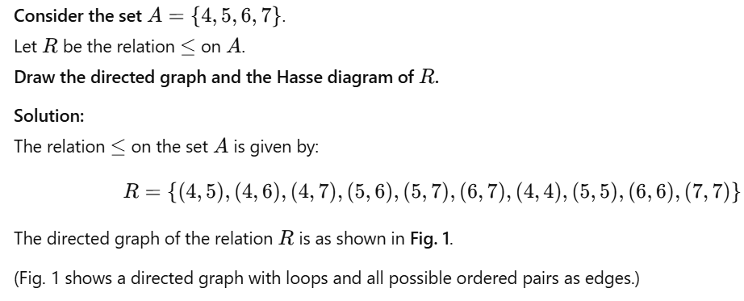
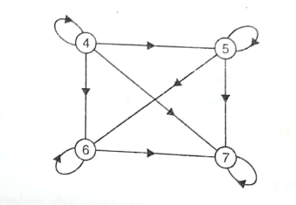
Hasse Diagrams
ns

Slide 8
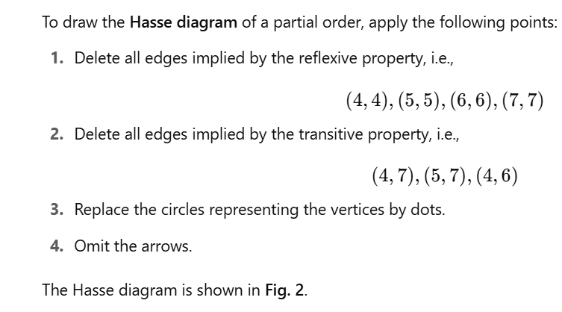

Hasse Diagrams
ns

Slide 9
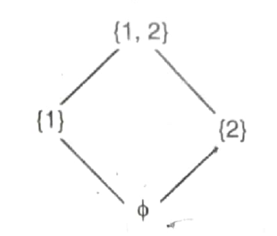
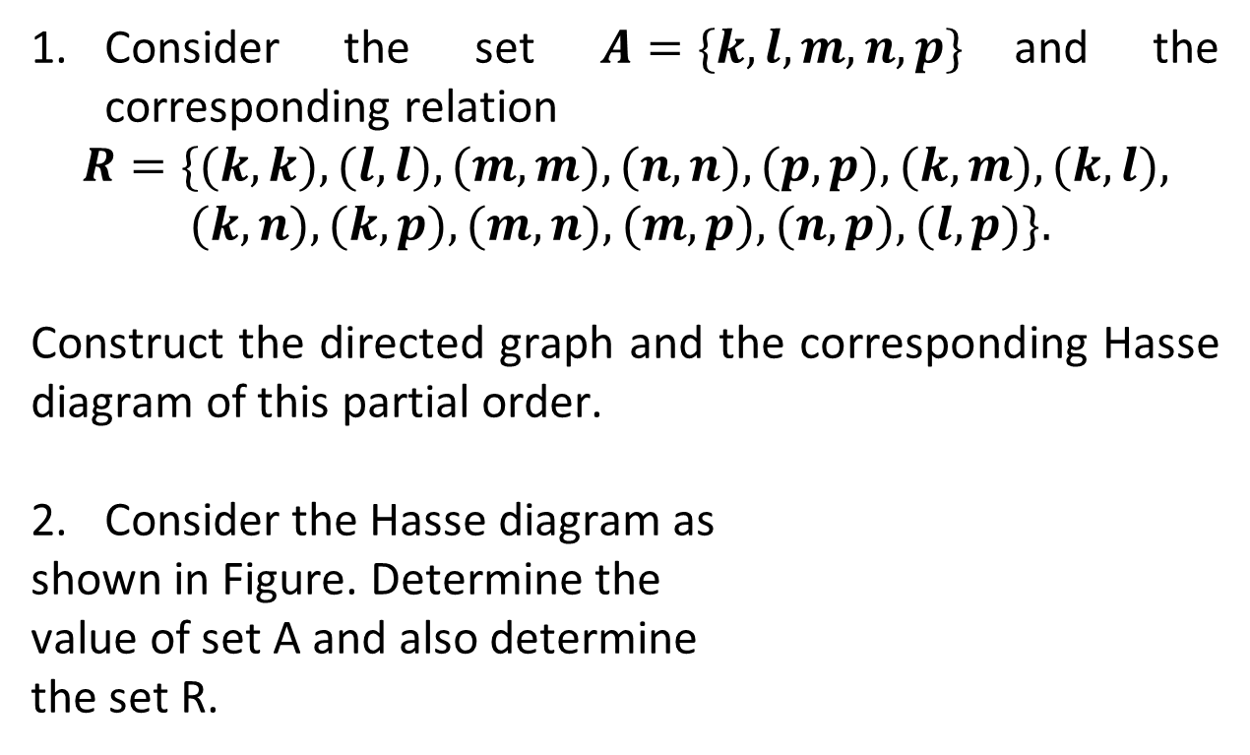
Activity
Consider the set $A=\{k,l,m,n,p\}$and the corresponding relation
$$R=\{(k,k),(l,l),(m,m),(n,n),(p,p),(k,m),(k,l),$$
$$(k,n),(k,p),(m,n),(m,p),(n,p),(l,p)\}.$$
Construct the directed graph and the corresponding Hasse diagram of this partial order.
Consider the Hasse diagram as
shown in Figure. Determine the
value of set A and also determine
the set R.

Slide 10
Conclusion
Hasse diagrams have been presented.
Lattices will be discussed in next topic.
ns

Slide 11
Video Links
https://youtu.be/JkYZGvW2aZM?si=mb-WGRch6IqlsVj_
https://youtu.be/qPtGlrb_sXg?si=Gk5wey5kY-NrSlkC

Slide 12
References
Sr. No. | Author | Name of the Book | Publisher | Year of Publication
1 | B.S. Grewal | Engineering Mathematics – I | Khanna Publishers | 2017
2 | B.V. Ramana | Higher Engineering Mathematics | Tata McGraw-Hill Education | 2009
3 | Erwin Kreyszig | Advanced Engineering Mathematics | Wiley | 2011
4 | N.P. Bali and Manish Goyal | Engineering Mathematics – I | Laxmi Publications | 2015
5 | S.K. Gupta | Mathematical Methods for Engineers | Wiley India | 2013

Slide 13
Thanks!!!

